Slide 1

Business Analytics II (BIS 244 – Chapter 8 part 1)
Refine Your Plots
BIS 244 – Fall 2022 – Dr. Davoodi

Slide 2

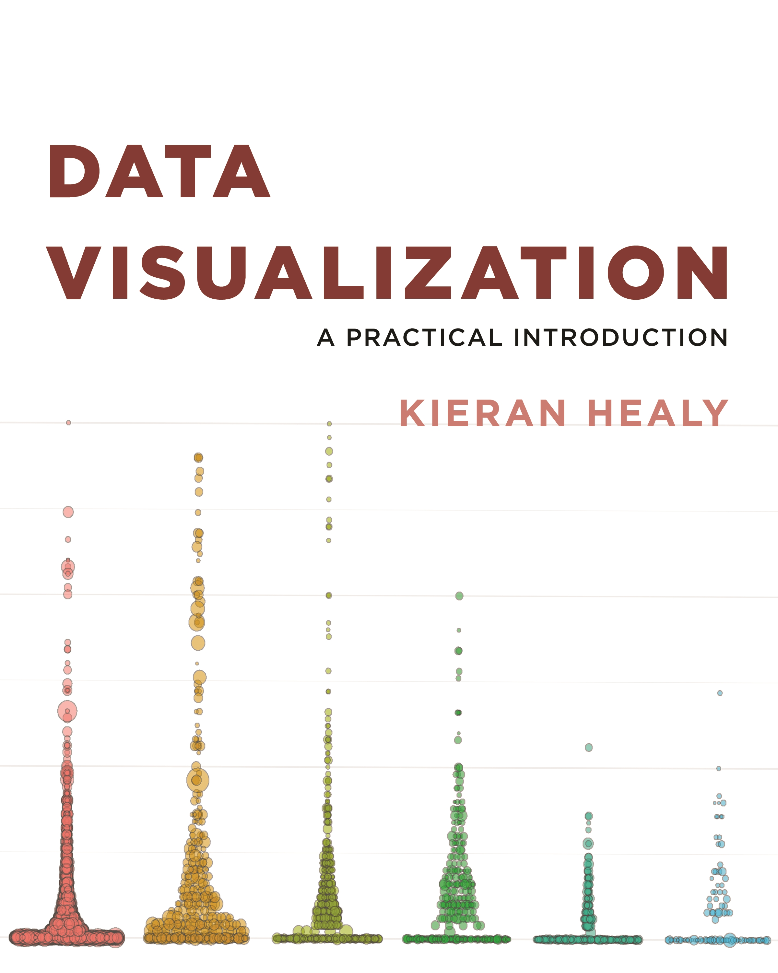
Chapter 8: Refine Your plot

Slide 3
Previously
Mostly used ggplot’s default output when making our plots
Geom_point
Geom_line
Geom_bar
Geom_col
Geom_Jitter
Geom_smooth
…
Not tweaking the default values for ggplot functions

Slide 4
Previously vs chapter 8
Our first part is considered as an exploratory data analysis
When we have some specific plot in mind, polishing the results comes up
Refining a plot can mean several things:
look at it just based on our own tastes and our sense of what needs to be highlighted.
format it in a way that will meet the expectations of a journal, a conference audience, or the general public
tweak this or that feature of the plot or add an annotation or additional detail not covered by the default output.
change the look of the entire thing

Slide 5
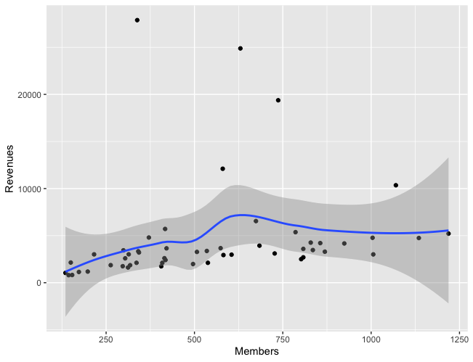
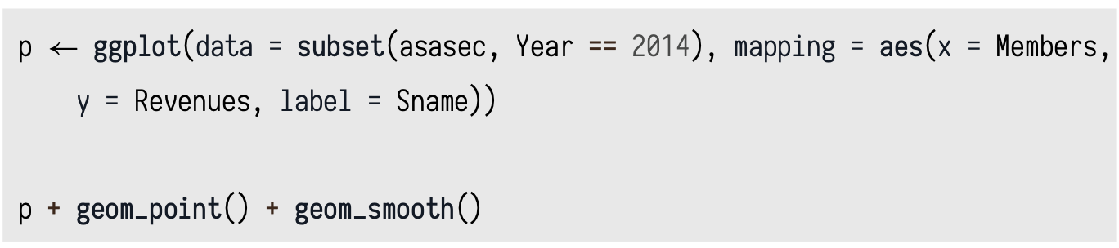
Example
American Sociological Association Section Membership dataset: asasec
Membership (2005-2015) and some financial information for sections of the American Sociological Association
Relationship between section membership and section revenues for a single year, 2014

Slide 6
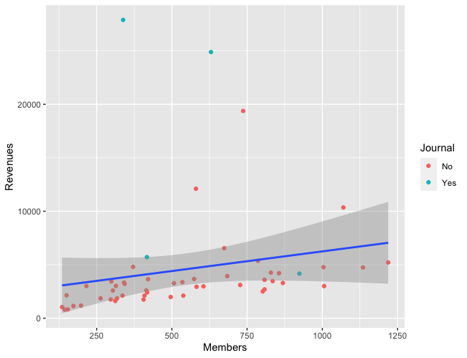
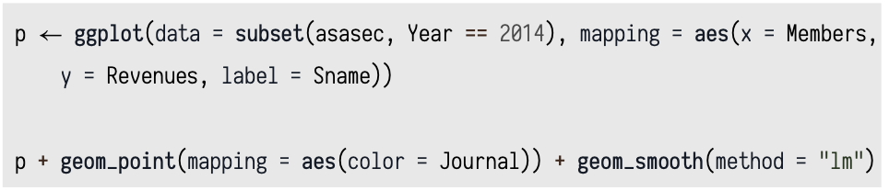
Example
Refine the previous plot:
The relationship seems linear not loess (default)
Outlier points may belong to those that do not have a journal

Slide 7
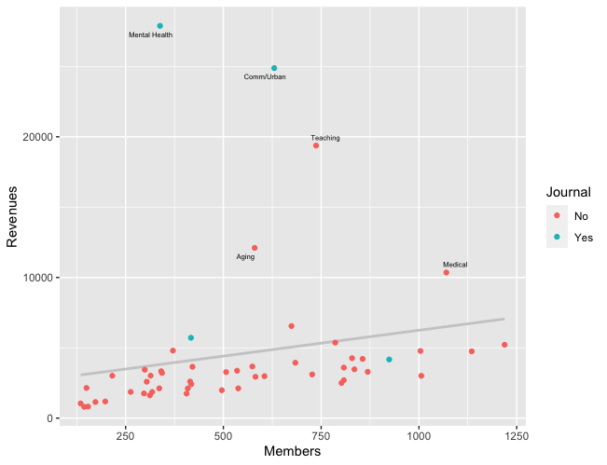
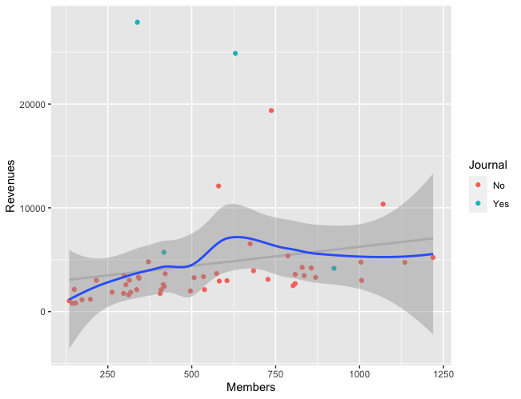
Example
Analyzing both plots in one figure to see linear or loess is well fitted
Use different colors for prediction lines
Still, we cannot answer why some points are far
Labeling those points may be helpful
Revenue is bigger than $10,000

Slide 8
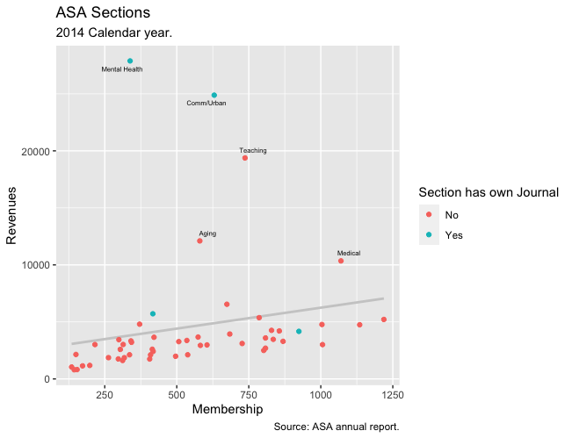
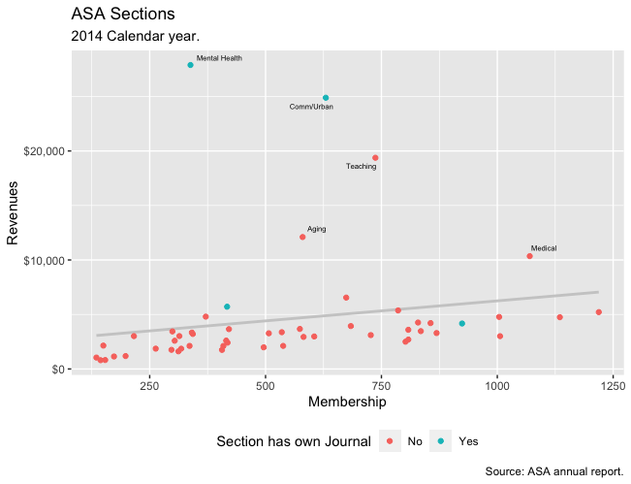
Example
Some more modification

Slide 9
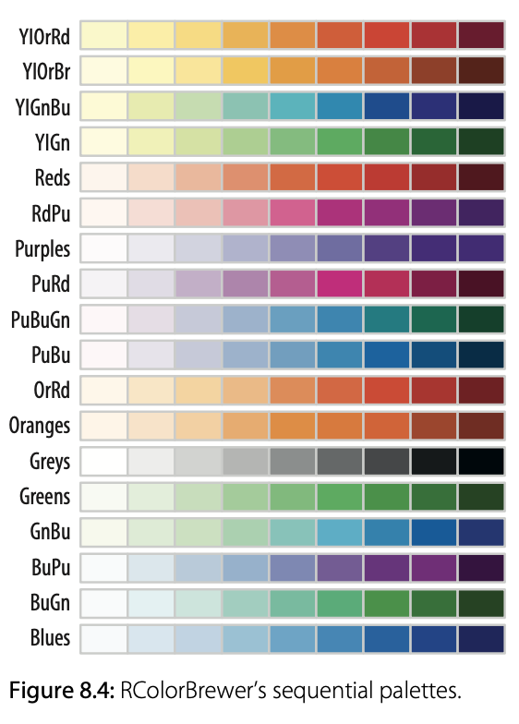
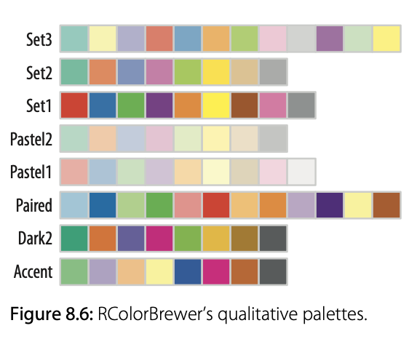
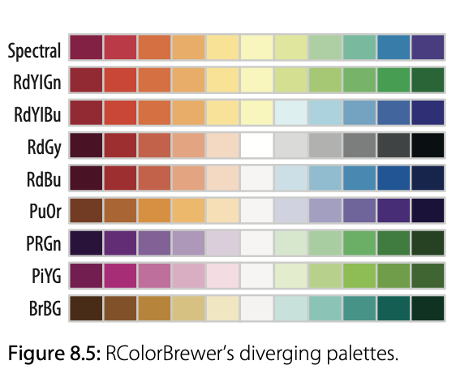
8.1 Use Color to Your Advantage
Use color to show differentness in a variable value (color palettes)
Sequential Palettes: visualization of data that is ordered and progresses from high to low
Diverging palettes: visualization of data that has an emphasis on middle values and both sides of the end values
Qualitative palettes: primary visual differences between different categories or groups of data

Slide 10
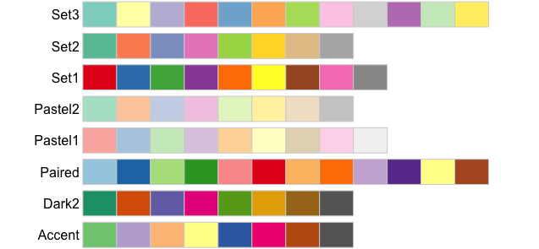
8.1 Use Color to Your Advantage
Extract 5 colors from ggplot()'s default palette
From the Qualitative palettes, choose one of them

Slide 11
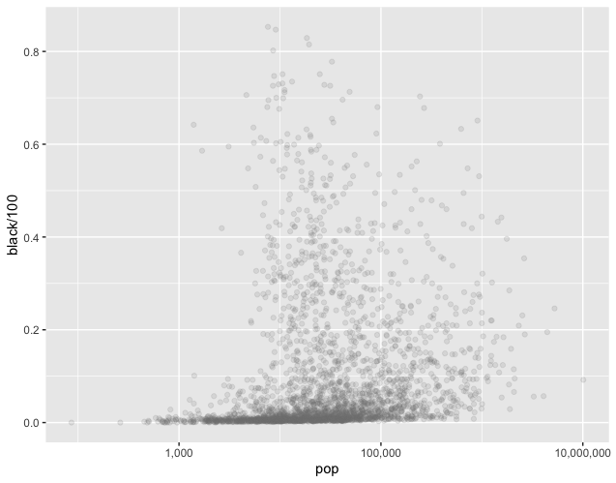
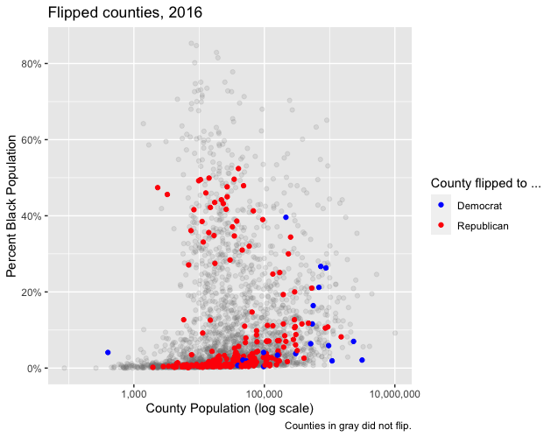
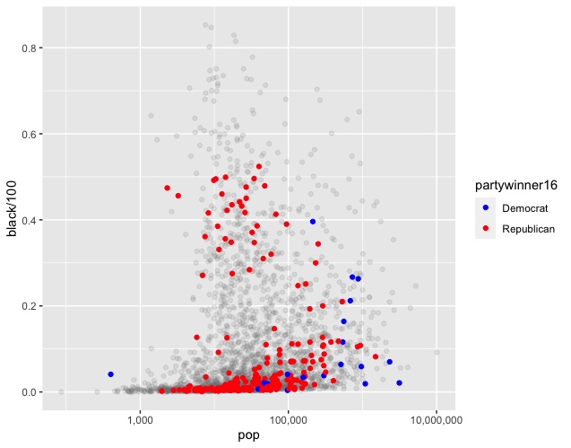
8.2 Layer Color and Text Together
Color is also useful when we want to pick out or highlight some aspect of our data.
Example: U.S. general election in 2016

Slide 12
Summary
In chapter 8 part 1, we learned how to use
For analyzing more in details, we may need to revise plots
Revising plots are necessary to get insights
We can use Color to give us some advantages to highlight some parts or variables
We learn to use different sets of colors
We learn to highlight different parts of plots based on hypothesis/questions

